Slide 1
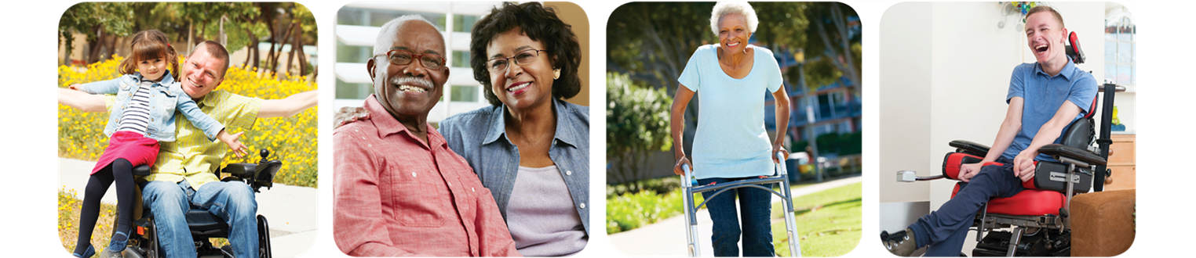
A Person-Centered Approach to Supporting
Individuals from Underserved Communities and Their Caregivers
Aging Empowerment Conference
Madison, WI
June 14, 2018

Slide 2
About Your Presenter
TASHA ORR-HOLMES is the Community Partnership Specialist at TMG, where she partners with people, their families and community toward the goal of living full lives in their community. She is dedicated to supporting individuals in their use of self-directed long-term support services. Her career experience includes supporting individuals and their caregivers on their journey living with Alzheimer’s and supporting underserved populations in accessing health care. Tasha lives in Milwaukee, Wisconsin with her family. Tasha’s personal experience as the caregiver for her grandparents fuels her passion and advocacy for others.
Contact Tasha at TSOrr-Holmes@tmgwisconin.com
DAVE VERBAN is the Senior Learning and Development Consultant at TMG by Magellan Health. He supports TMG’s culture of partnership by ensuring the principles of self-determination person-centered thinking are infused throughout the organization. He is also the Limited English Proficiency Coordinator and a member of TMG’s Civil Rights Compliance team. In 19 years at TMG, Dave has filled a variety of roles, always working to support TMG’s mission by amplifying the voices of people with disabilities, older adults, and their families. Prior to joining TMG, Dave worked in supported employment, and as an advocate for children and adults with disabilities and their families. In addition to his work with TMG, Dave also holds a part-time teaching position with the UW School of Medicine and Public Health. Contact Dave at DVerban@tmgwisconsin.com

Slide 3

Questions
What does it mean to be a caregiver?
Notes:
5 min
Tasha

Slide 4
Workshop Objectives
As a caregiver or support provider, how can we use person-centered thinking to partner with someone to help them maintain a meaningful life?
How can we empower caregivers to care for themselves out of love, not fear?
How can we apply a cultural lens to help improve the quality of life for older adults and the people who support them?
Notes:
1 min
Tasha

Slide 5
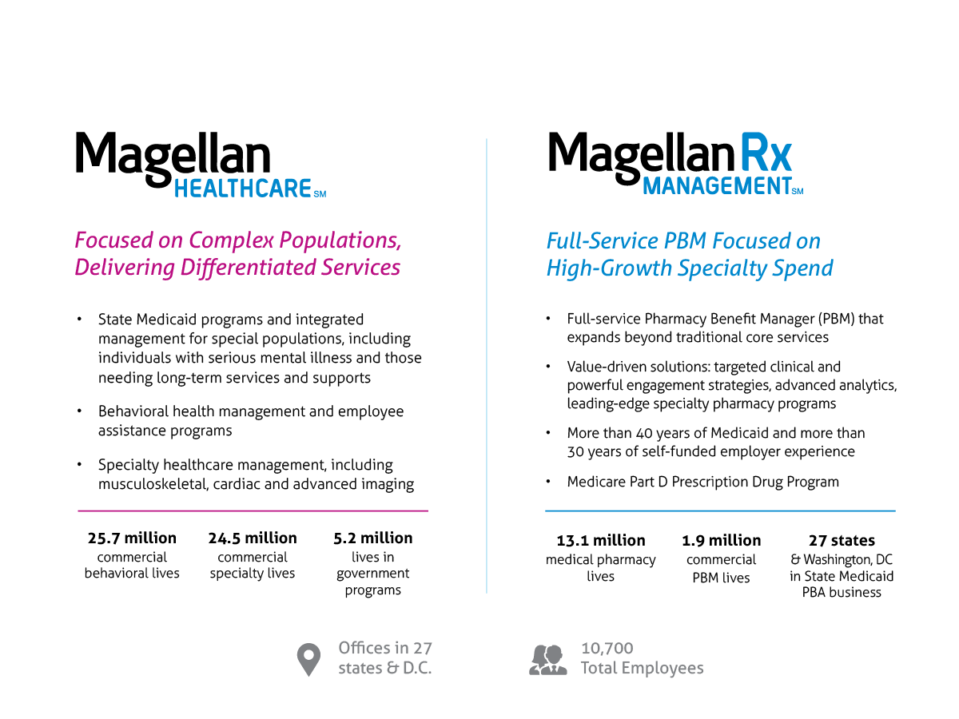
Magellan Health:
One Company, Two Unique Platforms
Notes:
Dave

Slide 6
Who is TMG?
We work with people to remain independent, in their
own homes and communities, with choice and control.
  IRIS Consultant Agency (ICA) since 2008 partnering with more than 14,000 people.
  Self Directed Personal Care (SDPC) Oversight Agency supporting over
  7,000 individuals in IRIS who have chosen SDPC.
  Quality Oversight for community-based services since 1986.
  Part of the Magellan Health family of companies.
    Locally-based operations with 600 staff in communities throughout Wisconsin.
Notes:
Dave

Slide 7

The Benefits of Self-Direction
The model advances the goals of home and community-based services to reduce institutionalization and supports people to build full lives.
Cost neutral from a State Medicaid standpoint.
People are incentivized to make their IRIS funds go as far as possible.
Self-direction can help address the workforce shortage through non-traditional participant-hired workers.
Notes:
Dave

Slide 8
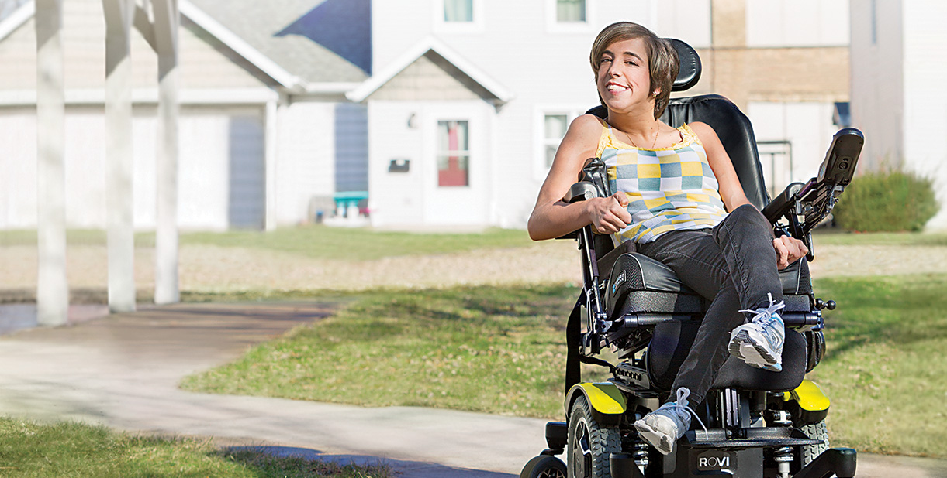
Clearing the Path Ahead
TMG partners with people to:
  Develop valued roles and community connections.
  Identify their short term and long term goals.
  Access local resources.
  Create individual support and services plans.
  Support responsible use of their plan budgets.
  Support people to find meaningful days through employment and community engagement.
Notes:
Dave

Slide 9
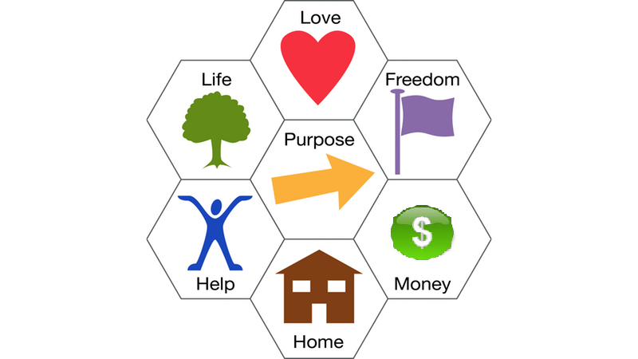
Citizenship
*7 Keys to Citizenship developed by Simon Duffy and Wendy Perez.
Graphic used by permission, citizen-network.org.
Notes:
6 min
Dave

Slide 10
Person-Centered Thinking
Values & Beliefs
Self-Determination
Control & Choice
Self Advocacy
Dignity of Risk
Empowerment
Supports
Notes:
3 min
Dave

Slide 11
Person-Centered Thinking
Practices
Cultural Humility
Strengths-Based Practices
Supported Decision-Making
Language that
Supports our Values
Through the person’s eyes
Notes:
2 min
Dave

Slide 12

Keeping the Family Together
A Journey
Notes:
10 min
Tasha’s story

Slide 13
Family Values
What values were most important to you as a child? As an adult?
Tradition, ritual
Hierarchy
Equality or equity
Religion
Independence
Work
Education
Money
Love
Food
Other?
Notes:
Cut if no time
Dave

Slide 14
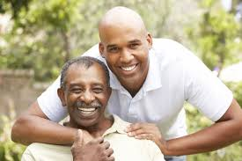
Who Are We Caring For?
Spouse or ex-spouse
Mother or father
Brother or sister
Grandparents
Significant other
Friend, neighbor
Client
Notes:
5 min
Tasha

Slide 15
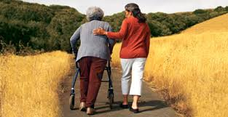
Why Do We
Become Caregivers?
“In sickness and in health.”
I’m the only one who would do it.
My family member would have done it for me.
I promised them I wouldn’t “put them away.”
No one can provide the care I can.
It just happened.
Family responsibility.
Cultural beliefs.
Notes:
5 min
Tasha

Slide 16


11 Symptoms of
Caregiver Stress
Denial
Anger
Social Withdrawal
Anxiety
Depression
Exhaustion
Sleeplessness
Irritability
Lack of Concentration
Health Problems
Guilt
Notes:
4 min
Tasha

Slide 17
The Impact of
Caregiver Stress
Higher Levels of Depression
Higher Levels of Stress & Frustration
Often in Worse Health than Non-Caregivers
Increased Risk of Heart Disease
Lower Levels of Self-Care
Notes:
4 min
Tasha

Slide 18

Tips For Dealing With Stress
Recognize warning signs early.
Identify sources of stress.
Identify what you can and cannot change.
Take action.
Notes:
5 min
Tasha

Slide 19
Resources for Caregivers
Wisconsin Institute for Healthy Aging (WIHA): Powerful Tools for Caregivers
  (www.wihealthyaging.org/powerful-tools-for-caregivers)
Department of Health Services (DHS): Dementia-Friendly Employers Toolkit
  (www.dhs.wisconsin.gov/dementia/employers.htm)
Notes:
1 min

Slide 20


Georgetown University
National Center for Cultural Competence
Notes:
1 min
https://nccc.georgetown.edu/resources/title.php
https://nccc.georgetown.edu/cop/

Slide 21
  Community of Practice on Cultural and Linguistic Competence in Developmental Disabilities
Notes:
15 min
Beth

Slide 22
Thanks!
Notes:
5 min
Questions/comments

